Slide 1

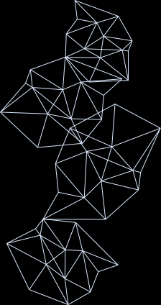

PRESENTATION
FESI Crew
Samuel Kosasih- 234232Z
Marcus Teo Ming Xuan - 230208B
Lee Yit Rhong Mattias - 231988D
Ryan Yong - 221084U

Slide 2
GOAL
Create effective machine learning model that is able to identify potential ‘repeat buyers’ that may come back to our platform,
so that the company can create better marketing strategies or campaigns to cater towards these buyers.
In our case- we are considering repeat buyers to be rows where customer_unique_id, from the customers dataset, are considered duplicates.

Slide 3
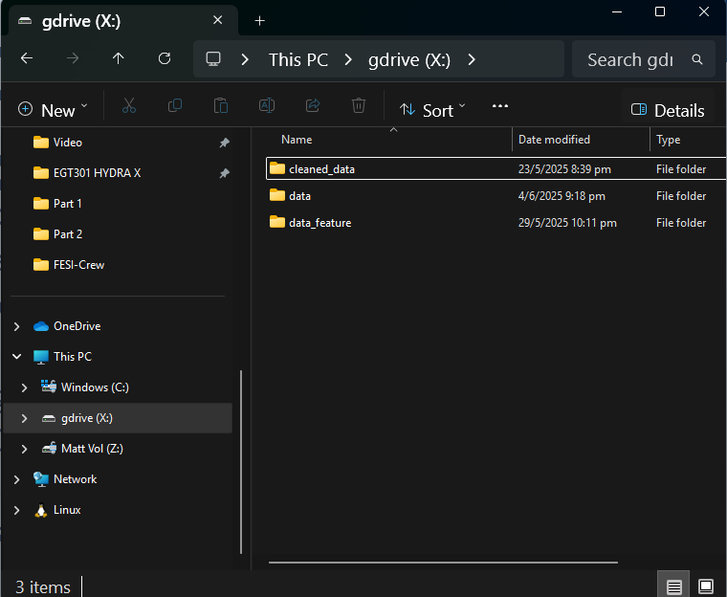
STANDARD INDUSTRY PRACTICES
winfsp/macfsp - Allows for creation of virtual drives, dedicated for data storage.
Rclone - Allows virtual drives to mount onto windows (C:).
Github is used for version control. However, it isn’t good with storing datasets. Hence through this practice, FESI Crew was able to easily update and share new altered dataset, via this virtual mounted drive, seamlessly among the members

Slide 4
DATA CLEANING
Delete Duplicate and null values used. Some duplicate and null values are useful. We kept them as they are able to contribute to accuracy/performance of model.
Combined and aggregated repeated useful data.
Ensure all data is mergeable. Ensure all identifiers (order_id, etc.) are unique. Future-proofing any data manipulation needed.
Data correlates with metadata provided by olist_datadict.xlsx

Slide 5
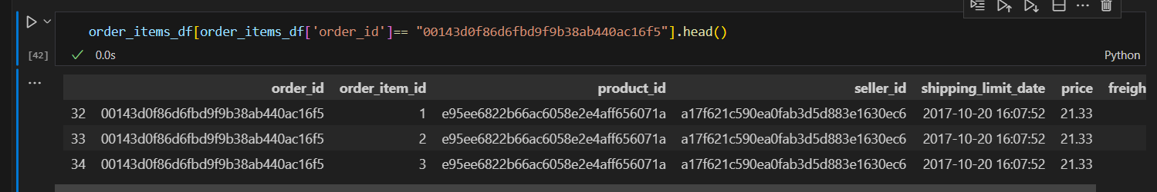
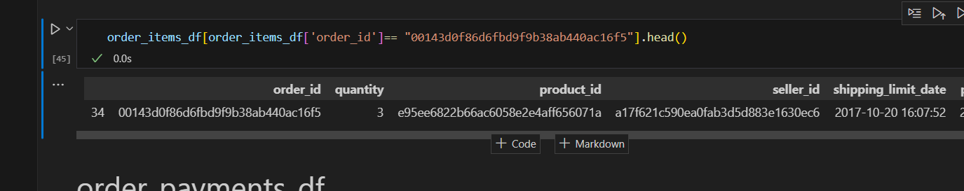
DATA CLEANING
EXAMPLE:
The following is an example of how we ensured the keys remain unique.
Order_items_df features:
When a customer buys 3 of the same product, it is registered as 3 different rows.
Hence same product ID, same order ID, but different order_item_id.
We removed the rows with the lower “order_item_id”, leaving only the row with the highest order_item_id, then renaming the column into ‘quantity’.
We summed the price and freight value as well.

Slide 6
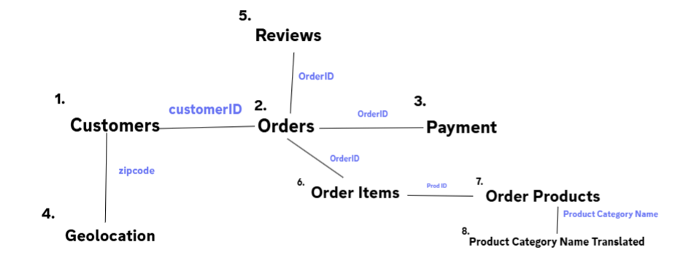
DATA MERGING
Correlation Table:
We merged the datasets as above so it is ready for feature engineering and machine learning.

Slide 7
FEATURE ENGINEERING
Recency – days since their last order
Frequency – how many orders in the last 6 months
Monetary – total & average spend
Behaviour – delivery-on-time rate, average shipping delay, review score/count
Target - Target for our Machine Learning Model

Slide 8
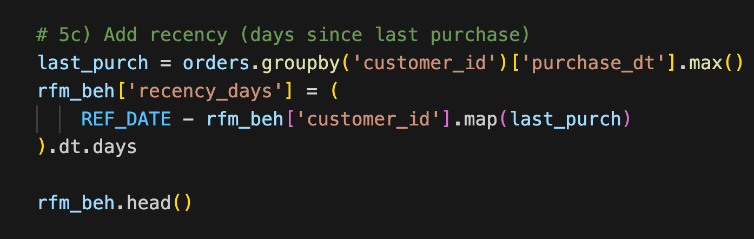
FEATURE ENGINEERING
Recency - Finds each customer’s most-recent purchase_dt, subtracts it from the reference date, and stores the result in recency_days. Smaller gaps → More engaged

Slide 9
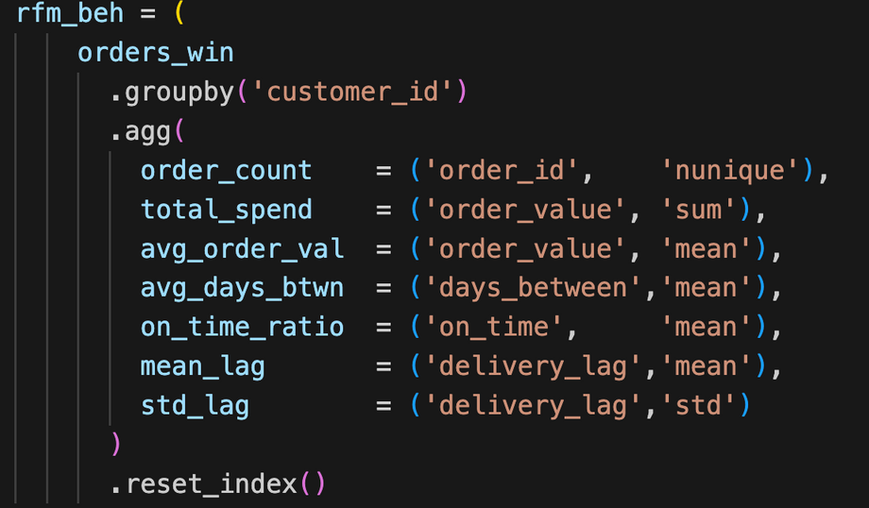
FEATURE ENGINEERING
Frequency – counts each customer’s orders
Monetary – total spend and average order_value per customer.

Slide 10
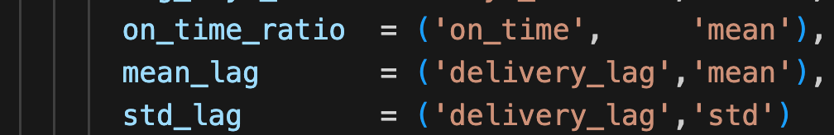
FEATURE ENGINEERING
Behaviour (Delivery) - Tag every order on-time or late and record its delivery lag in days.
on_time_ratio — % of their orders that arrived as promised
mean_lag — average shipping delay
std_lag — consistency of that delay
Higher on-time ratios and lower, steadier lags are strong signals a customer will order again.

Slide 11
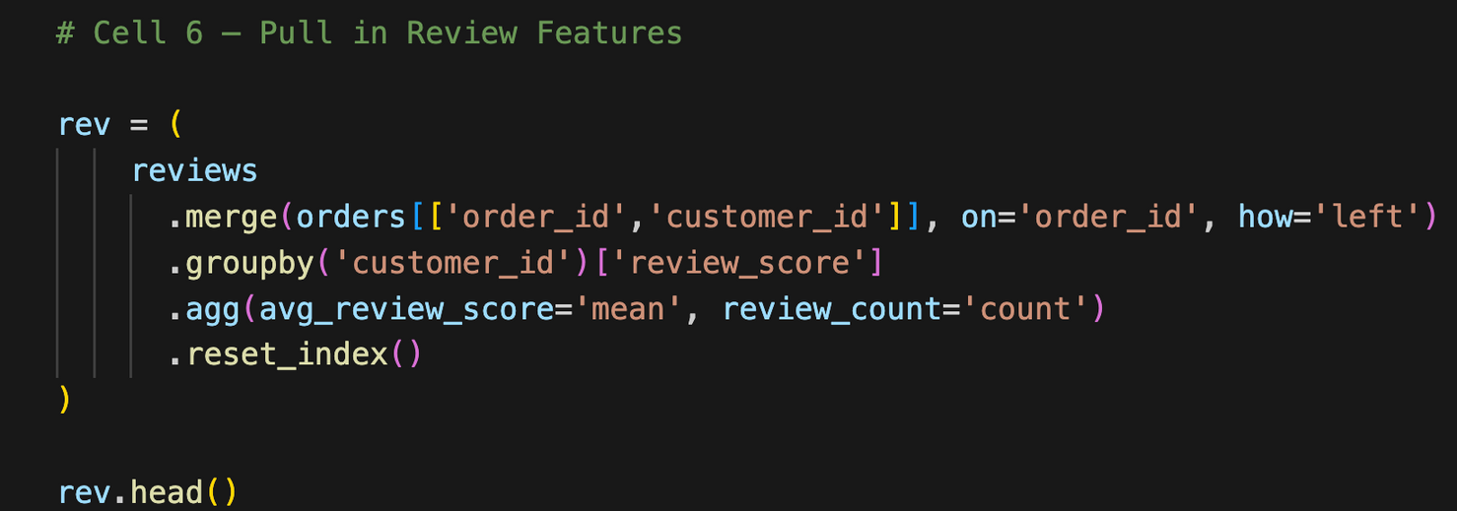
FEATURE ENGINEERING
Behaviour (Reviews) – Joined reviews to orders via order_id
Per customer, calculate:
Average rating
Total review count

Slide 12
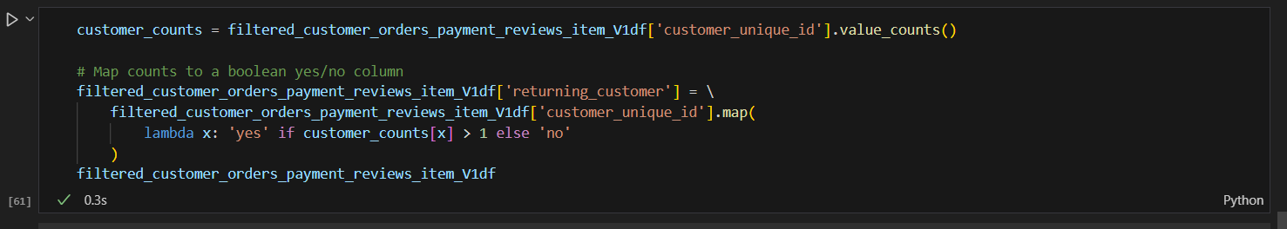
FEATURE ENGINEERING
Target -To identify returning customers

Slide 13
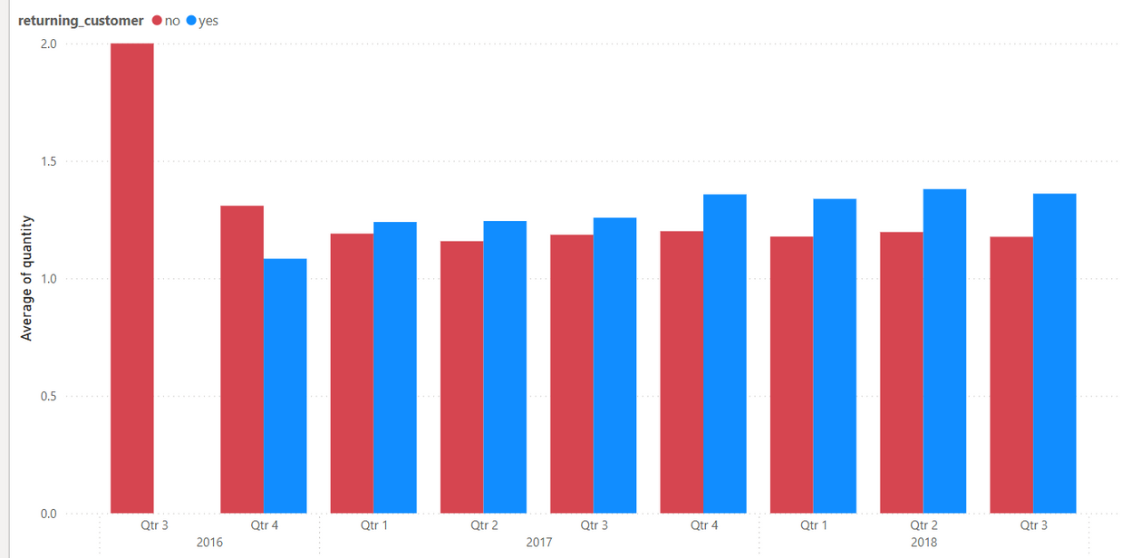
INSIGHTS
Do take note that data was only collected from 2016Q3 to 2018Q3.

Slide 14
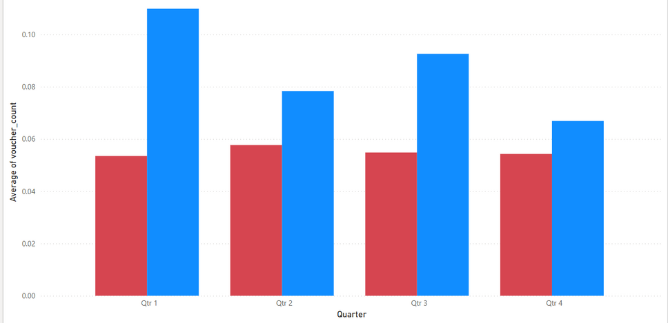
INSIGHTS
Average Voucher Used:
2. On average, returning customers tend to use more vouchers as compared to non-returning customers.
For example, in Q1, the average voucher used for returning customer was 0.11, where as non-returning customers used an average of 0.05.

Slide 15
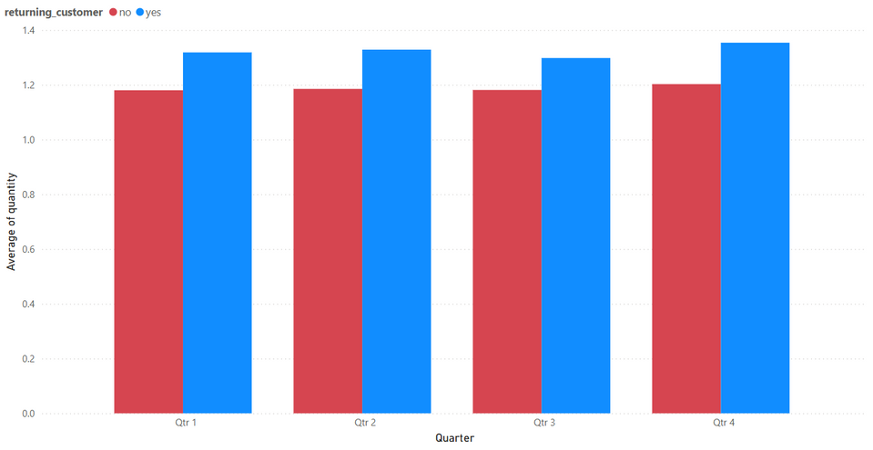
INSIGHTS
Average amount of items bought
3. Returning customers tend to buy more items as compared to non-returning customers

Slide 16
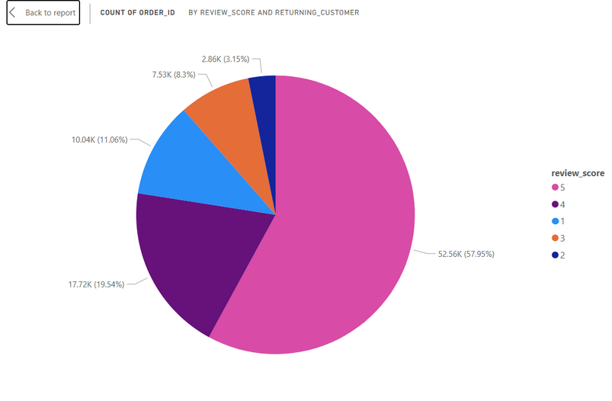
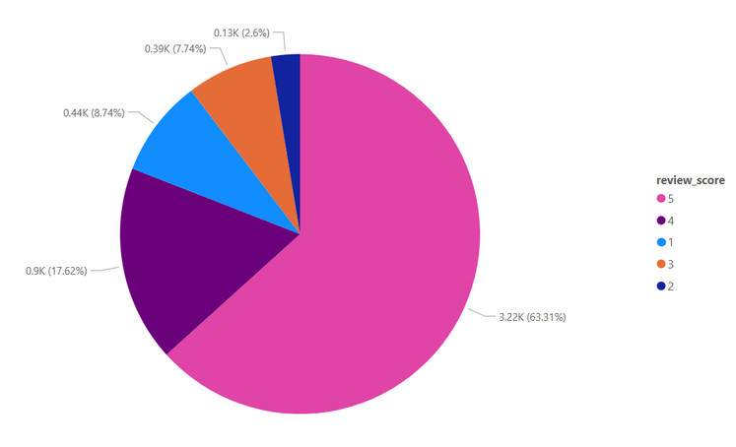
INSIGHTS
Review score of
Non Returning Customers
Review Score of
Returning Customers
4. Returning customers are slightly more satisfied than non returning customers.
63% of returning voted for 5 star reviews, while only 57% on non-returning
11% of non returning voted for 1 star, while only 8% of returning did so.

Slide 17
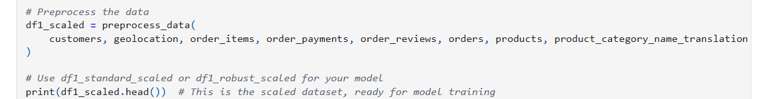
MACHINE LEARNING INGESTION
We defined a function (preprocess_data() )where it merges all datasets/data that is needed for the machine learning model (random forest).
We imported the function from our datapreparation.py, then ran our uncleaned data for our machine learning ready dataset

Slide 18
MACHINE LEARNING MODEL
For our model, we have decided to choose a random forest model.
Returning customer (our target) is a binary class (YES/NO), which is well suited for classification models such as random forest.
Random forest is able to handle large amounts of data, such as 90k rows of data.
As there are way more non-returning customers than returning customers, it is very easy for our model to become overfitted. Random forest is able to reduce overfitting and is therefore the most optimal model for this scenario.

Slide 19
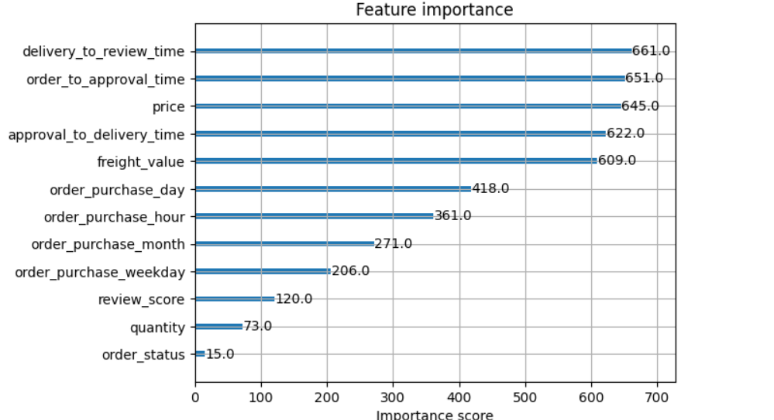
MACHINE LEARNING INSIGHTS
Top feature importance:
Time or date related features seem to play a huge part in feature importance. For example, order_to_approval time have a feature importance of 651
2. Price and freight value also plays a big part in feature importance as well, having a score of 645 and 609 respectively
3. Quantity and Review score does not seem to play a big part in terms of feature importance, only having a score of 73 and 15.

Slide 20
MODEL RESULTS
Precision
Recall
F1-Score
Support
We have an overall accuracy of 94.43%, and a weighted average accuracy of 0.92.
This means that our model is capable of identifying repeat customers reliably.

Slide 21
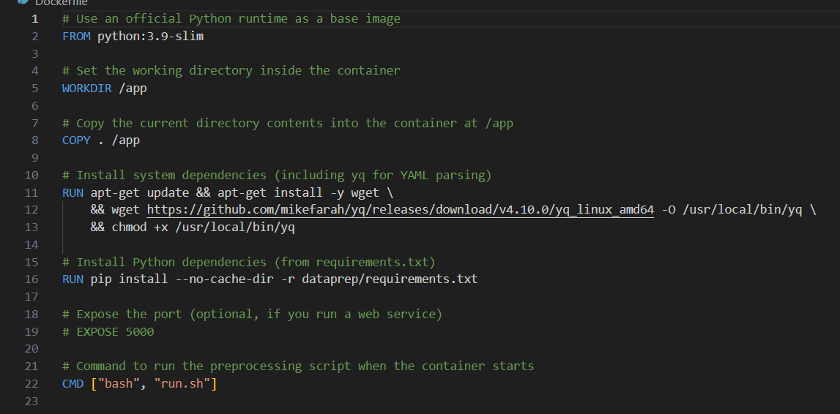
DOCKERFILE

Slide 22
THANK YOU
Q&A Time!

